Slide 1
Agenda
Software Architecture Process
Software Architecture Process
System Requirements
  Functional Requirements
  Non-Functional Requirements
Architecture Design
  High-Level Design
  Low-Level Design
Architecture Evaluation
  Quality Attributes *-ilities
Architecture Documentation
Architecture Implementation
Strategic Approach For Choosing Tech Stack

Slide 2
Software Architecture Process
1. Requirements
2. Design
3. Evaluation
4. Documentation
5. Implementation

Slide 3
1. System Requirements
Functional Requirements: What the System do?
  Business Flows
  Business Services
  User Interfaces
Non-Functional Requirements: What should the System deal with?
  Performance
  Load
  Data Volume
  Concurrent User
  SLA
Notes:
Non-Functional Requirements are Important. Do Not Ignore
Functional Requirements are Part of the Business

Slide 4
1.2 Non-Functional Requirements
Define Non-Functional Requirements
Always Discuss Numbers
Client won’t be able to define them
Never begin working on a system without Non-Functional Requirements

Slide 5
1.2.1 Non-Functional Requirements: Performance
Latency: Time to complete a single task?
  Saving user data to database: 50-300ms (typical for well-designed API)
  Reading a single file from filesystem: 5-50ms (SSD/local storage)
  API response time (end-to-end): 100-500ms (depends on network, DB, logic)
Throughput: Total tasks completed per second/minute?
  User saves per minute:
    Well-optimized API: 5,000–10,000+
    Poorly optimized API: < 500
  File reads per second:
    Local SSD: 10,000–50,000
      Poorly optimized: < 1,000
    Network/cloud storage: 1,000–5,000
      Poorly optimized: < 1,00
Notes:
Key Factors Affecting Performance
Database (Indexing, query optimization, connection pooling)
Storage Type (SSD vs HDD, local vs cloud)
API Design (Async vs sync, caching, load balancing)
Network Latency (Geographical distance, CDN usage)

Slide 6
1.2.2 Non-Functional Requirements: Load
Quantity of Work Without Crashing
For example: In WebAPI, How many concurrent requests without crashing
  Well-optimized API: 5,000–10,000+ concurrent connections
  Poorly optimized API: < 500 concurrent connections
Always Plan for Extreme Cases: Design for 3-5x your peak traffic
Load Testing Tools: Azure Load Testing (Based Upon Apache JMeter), K6, Jmeter and Locust etc.
Load vs Throughput
Throughput: 100 requests / sec
Load: 500 concurrent requests (5x) without crashing
Notes:
Load Testing Tools: Azure Load Testing (Based Upon Apache JMeter), K6, JMeter, Locust,

Slide 7
1.2.3 Non-Functional Requirements: Data Volume
How Much Data the System Will Accumulate Over Time
Helps With:
  Database selection (SQL vs NoSQL, serverless vs provisioned)
  Query design (indexing, partitioning, archiving strategy)
  Storage costs (scaling budget, backup retention policies)
Data Volume Aspects:
  Initial Data (Day 1)
    Example: 500MB (user profiles, configs, seed data)
    Plan for: 3x buffer (→ 1.5GB allocated)
  Annual Growth
    Example: 2TB/year (user-generated content, logs, analytics)
    Factors:
      Active users × data/user/month (e.g., 10K users × 5MB/user = 50GB/month)
      Audit logs/telemetry (~15% extra)
      Legal retention policies (e.g., 7-year logs)

Slide 8
Database/Storage Selection Guide
Data Scale | SQL DB (Azure SQL) | NoSQL (CosmosDB) | Data Lake / Warehouse | Big Data (Hadoop/Spark)
< 50GB | Single server | Serverless tier | Overkill | Never
50GB–1TB | Read replicas (Premium tier) | Partitioned | Cold tier (Blob Storage) | Overkill
1TB+ | Azure SQL Hyperscale | Auto-scale + RU adjustment | Hot tier + Delta Lake | Synapse Spark
10TB+ | Azure SQL Hyperscale (upto 100TB) | Global distribution: - Cosmos DB (multi-region) - Cassandra (multi-DC) | Lakehouse: - Databricks + Unity Catalog - Snowflake + Iceberg | Spark clusters: - Databricks - HDInsight(Spark)
100TB+ | Azure Synapse SQL (dedicated pool) | Azure Cosmos DB (unlimited scale) | Tiered storage: - Hot (S3/ADLS) - Cold (Glacier/Archive) - Metadata (Delta/Iceberg) | Spark pools + AKS

Slide 9
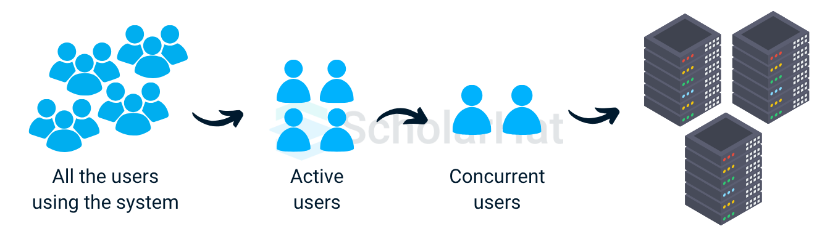
1.2.4 Non-Functional Requirements: Concurrent Users
How many Users can use the System simultaneously
For Example:
  If your API handles 100 requests/sec
  Average user session lasts 30 seconds (e.g., browsing a dashboard)
  Concurrent Users = 100 × 30 = 3,000
Formula:
  Concurrent Users = (Peak Requests per Second × Avg. Session Duration in Seconds)

Slide 10
1.2.5 Non-Functional Requirements: SLA
Required Uptime for the System
Check Your Resources SLA like Azure VM, Azure SQL SLA
Manage Client’s Expectations, 99.999% uptime is not a Realistic Goal
99.99% SLA is Equals to:
  24 X 365 = 8760 hrs / year
  8760 X 99.99% = 8759.12
  8760 - 8759.12 = 0.88 hrs downtime / year

Slide 11
Composite SLA
Suppose in your Project you have:
  Two virtual machines
  One instance of Azure SQL Database
  One instance of Azure Load Balancer
Composite SLA
  = 99.9% × 99.9% × 99.99% × 99.99%
  = 0.999 × 0.999 × 0.9999 × 0.9999
  = 0.9978
  = 99.78%

Slide 12
2. Architecture Design
High-level Design
  Develop a high-level architecture that outlines the system's structure, identifying major components and their interactions.
  Choose an architectural style or pattern (e.g., microservices, monolithic, event-driven) that suits the project's requirements.
Low-level Design
  Specifies the implementation details of each component, including class diagrams, database schemas, and API specifications.
  Make key decisions regarding the technology stack, data models, communication protocols, and other architectural elements.

Slide 13
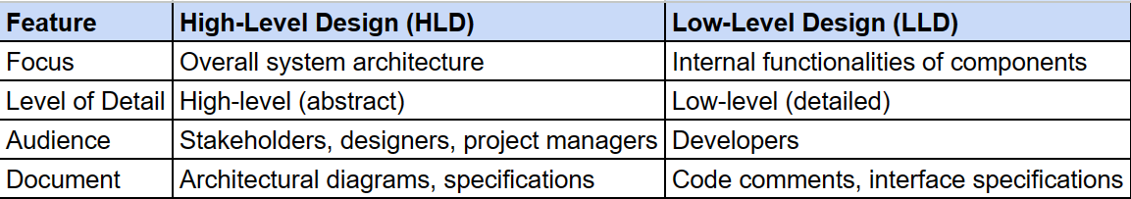
High-level Design vs. Low-level Design
HLD: Provides a clear vision for the system, ensuring everyone agrees on the approach before development starts.
LLD: Offers a step-by-step guide for developers, minimizing confusion and rework during implementation.
Notes:
HLD: Provides a clear vision for the system, ensuring everyone agrees on the approach before development starts.
LLD: Offers a step-by-step guide for developers, minimizing confusion and rework during implementation.

Slide 14
3. Architecture Evaluation
Architecture Review
  Review the architecture to ensure it meets the requirements and follow the best practices.
  Do peer reviews, prototyping, and evaluate the architecture using ATAM (Architecture Tradeoff Analysis Method).
Quality Attribute Analysis
  Assess the architecture’s ability to achieve desired quality attributes such as scalability, security, maintainability, and availability.

Slide 15
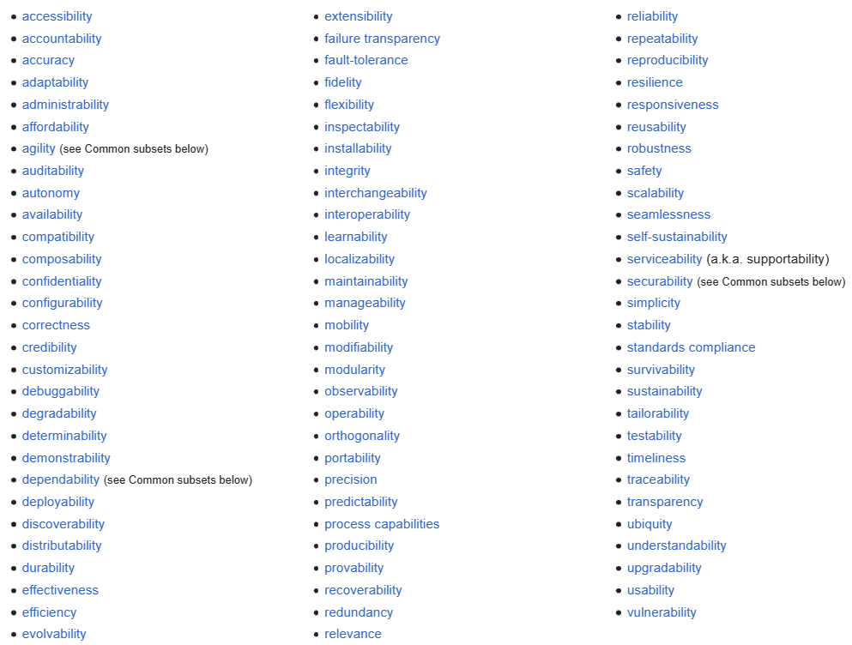
3.1 Quality Attributes: *-ilities
Scalability
Manageability
Modularity
Extensibility
Testability
Reliability
Availability
Source: https://en.wikipedia.org/wiki/List_of_system_quality_attributes
Notes:
Technical capabilities that should be used to fulfill the non-functional requirements

Slide 16
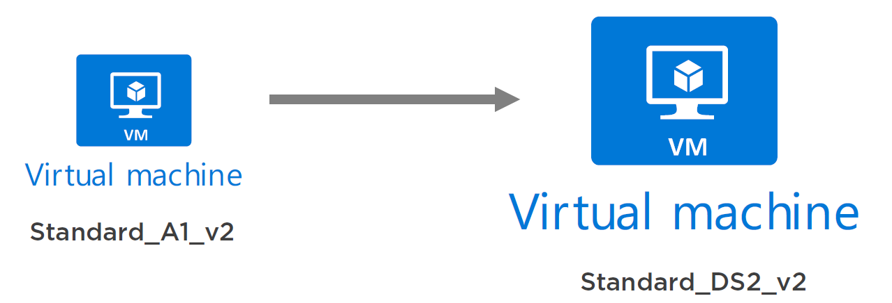
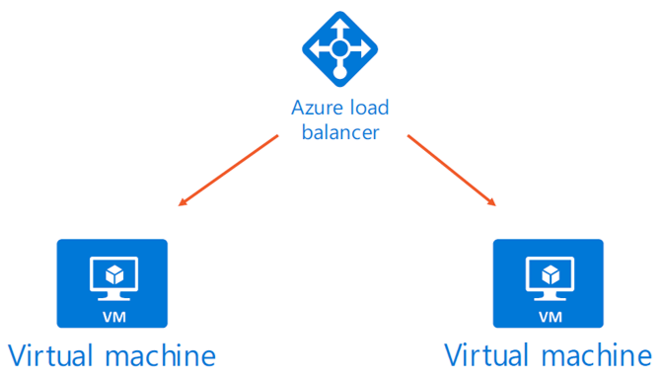
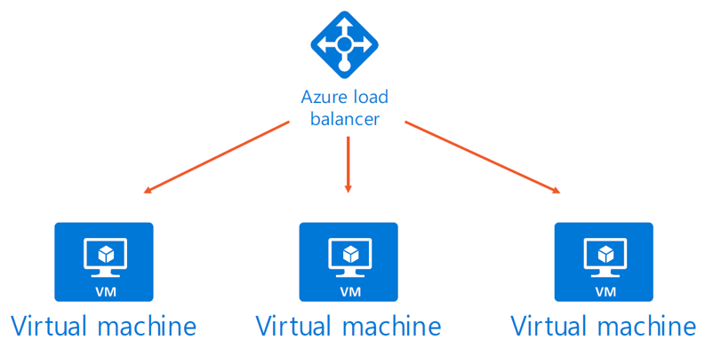
3.1.1 Scalability
Adding Computing Resources without any interruption
There are two types of Scaling:
  Vertical Scaling
  Horizontal Scaling
Scale Down
Scale Up
Scale out
Scale In

Slide 17
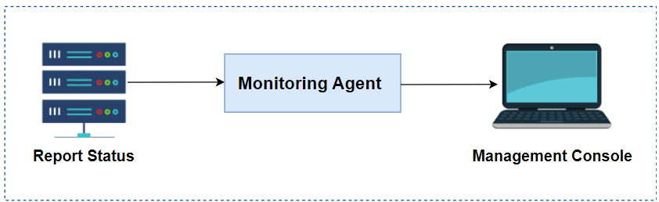
3.1.2 Manageability
Know what is going on and take actions accordingly

Slide 18
3.1.3 Modularity
A system that is built from building blocks, that can be changed or replaced without affecting the whole system.
User
Cart
Payment
Order
Auth
Catalogue

Slide 19
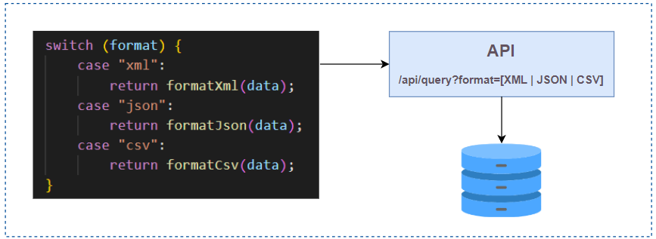
3.1.4 Extensibility
A system functionality can be extended without modifying its existing code.

Slide 20
3.1.5 Testability
How easy it to test the application?
Independent modules and methods
Single responsibility

Slide 21
3.1.6 Reliability
A system is said to be reliable if it can continue to function correctly and remain available for operations even in the presence of partial failures.
It is measured as the probability of a system working correctly in a given time interval

Slide 22
3.1.7 Availability
A probability of a system working correctly at any given time and being available for operations
  Time based availability:
  availability= uptime / (uptime + downtime)
  Request based availability:
  availability= successful requests/total requests
There can be downtime, but the system is expected to recover from the same in a quick time

Slide 23
4. Architecture Documentation
Architectural Artifacts
  Create documentation to describes the architecture, including diagrams, component definitions, and interaction models.
  This documentation should cover both HLD and LLD details.
Maintenance
  Update documentation to reflect changes and decisions made during the development process and maintenance phase.

Slide 24
5. Architecture Implementation
Guidance
  The architecture serves as a blueprint for developers, guiding the system's implementation with defined standards, technologies, and patterns.
Iteration
  Implementation often uncovers the need for adjustments in the architecture, requiring an iterative approach to refining architectural decisions.

Slide 25
Strategic Approach For Choosing Tech Stack

Slide 26
#1: Strategic Approach For Choosing Technology Stack
Open Source or Commercial: Decide based on community support, flexibility, reliability, dedicated support (commercial).
Vision and Roadmap: Ensure the technology aligns with your project goals and has a clear, evolving roadmap.
Community Engagement: Check GitHub for activity levels, contributions, and user feedback.
Developer Experience: Gather feedback on the learning curve, strengths, and weaknesses from the developer community.
Ecosystem: Evaluate the range of integrations, plugins, and tools available that can enhance development efficiency.
Maintenance and Updates: Regular, stable updates indicate a commitment to quality and addressing user needs.
Documentation: Good documentation and learning resources are essential for efficient problem-solving and onboarding.
Performance and Scalability: Ensure the technology can handle growth and performs well under increased loads.
Security: Assess the technology's security features and its history of addressing vulnerabilities.
Compatibility: Ensure it integrates well with your existing stack and the tools you plan to use.
Licensing and Costs: Understand the financial and legal implications, including licensing fees and potential long-term costs.
Developer Availability: Consider the availability of skilled developers familiar with the technology for recruitment ease.

Slide 27
#2: Strategic Approach For Architecture Selection
User Growth Projections
Current Stage: 10,000 daily users, amounting to 300,000 monthly.
After 1 Year: Projected to double to 20,000 daily users, reaching 600,000 monthly.
Project Planning
Methodology: Adopt Agile/Scrum for flexible, iterative development, complemented by a Kanban board for visual project management and workflow visualization.
Architectural Principles
Clean Architecture: Emphasize the separation of concerns to ensure scalability, maintainability, and flexibility.
API-Centric Design: Implement an API-based architecture to facilitate easy integration between different frontends and the backend, supporting:
  Website
  Mobile App

Slide 28
#2.1: Strategic Approach For Architecture Selection
User Growth Projections
Current Stage: 1,00,000 daily users, amounting to 30 millions monthly.
After 1 Year: Projected to double to 2,00,000 daily users, reaching 60 millions monthly.
Project Planning
Methodology: Adopt Agile/Scrum for flexible, iterative development, complemented by a Kanban board for visual project management and workflow visualization.
Architectural Principles
Microservices Architecture: Use microservices architecture to ensure scalability, fault isolation, and CI/CD.
Microservices Patterns: Implement microservices principles and patterns as:
  Decomposition Patterns
  Integration Patterns
  Communication Patterns
  Cross-Cutting Concerns Patterns
  Observable Patterns
  Database Patterns
  Deployment Patterns

Slide 29
#3: Strategic Approach For Technology Selection
Backend
Skills: Proficiency in Java or .NET Core
Performance: Compare the framework performance metrices.
Frontend
React: For building dynamic, responsive user interfaces.
Spring Boot MVC: For server-side rendering, offering quick load times and SEO benefits.
Bootstrap: For rapid, responsive design.
Database
SQL (ACID compliant): Ideal for transactions and complex queries. Consider Oracle, PostgreSQL, or MySQL based on licensing and ecosystem preference.
NoSQL: For scalability and handling unstructured data. Options like Cassandra, MongoDB, or CosmosDB cater to different needs, including document storage and horizontal scaling.

Slide 30
Strategic Approach For Technology Selection Contd.
Cache and CDN
Redis Cache: Enhance performance and reduce load times.
Content Delivery Network (CDN): Distribute static content like images, static files (JS, CSS, Audio, Video) globally to improve user experience.
Messaging Services
Message Brokers: RabbitMQ or Azure Service Bus for reliable message queuing.
Stream Processing: Kafka or Azure EventHub for high-throughput, real-time event streaming.

Slide 31
#4. Strategic Approach For Deployment
Performance Optimization
Cache: Implement Redis to enhance performance and reduce database load.
CDN: Use CDN to server static content like images, js, css assets
Cloud/DevOps
Azure: As the cloud provider, leveraging its vast services, including database, computing, and storage solutions.
CI/CD Pipeline: Utilize Azure DevOps, GitHub Actions, or Jenkins for continuous integration and delivery, ensuring quick and reliable deployment cycles.
Monitoring
Monitoring and Logging: Use tools like Serilog and Application Insight for real-time monitoring and logging to quickly identify and resolve issues, ensuring a smooth user experience.

Slide 32
Strategic approach to deployment Contd..
Containerization: Docker for creating lightweight, portable service containers.
Orchestration: Kubernetes, specifically AKS (Azure Kubernetes Service), for managing containerized applications at scale.

